Slide 1
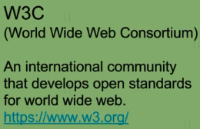
What are SOAP Web Services?

Slide 2
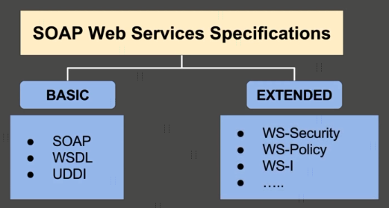

What are SOAP Web Services?

Slide 3




What are SOAP Web Services?
Request
Client
(Service Consumer)
Server
(Service Provider)
Response

Slide 4

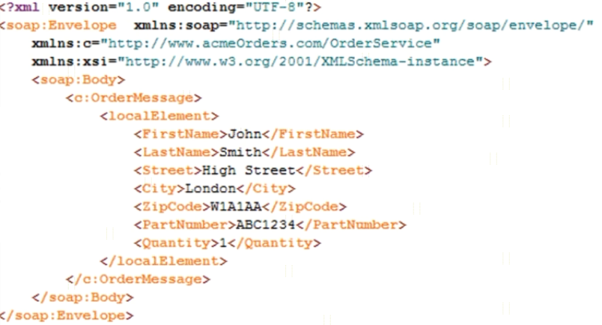
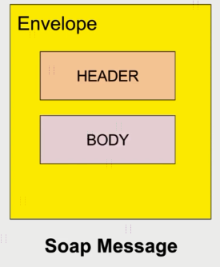
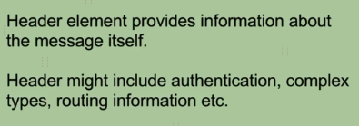

What are SOAP Web Services?

